Slide 1
CSET301 – AI-ML
Lecture 17 : Vanishing and exploding gradient

Slide 2

Vanishing Gradient
Vanishing gradients occur when error gradients become very small during backpropagation, hindering convergence.
Exploding Gradient
Exploding gradients occur when error gradients become very large, disrupting learning. It can be addressed through lower learning rates, gradient clipping, and gradient scaling.

Slide 3
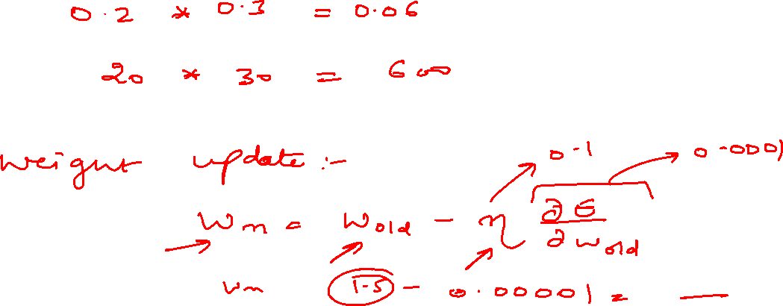
Vanishing Gradient
Vanishing means “disappearing”. Vanishing gradients means error gradients becoming so small that we barely see any update in weights. Hence, convergence is not achieved.

Slide 4









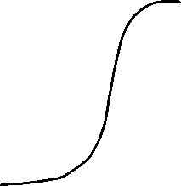




Slide 5
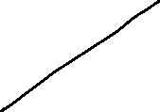

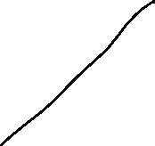












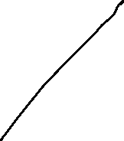




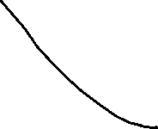


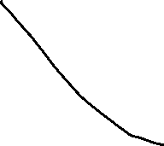




Slide 6
